Slide 1


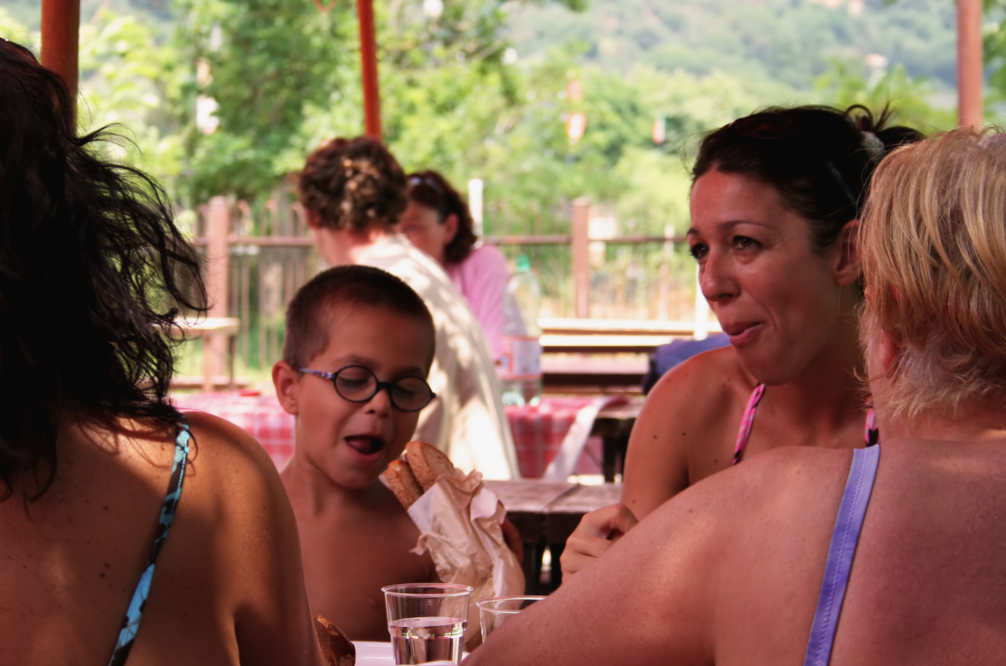
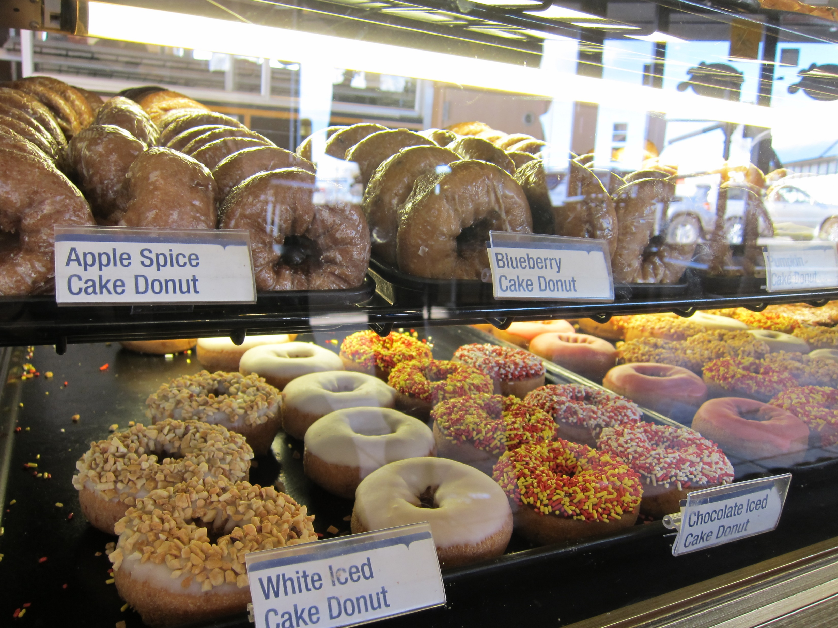
Menu About Us Contact
The finest in breakfast treats and coffees since 1971
Fun donut joke
What kind of donuts can fly? A plain one.

Slide 2
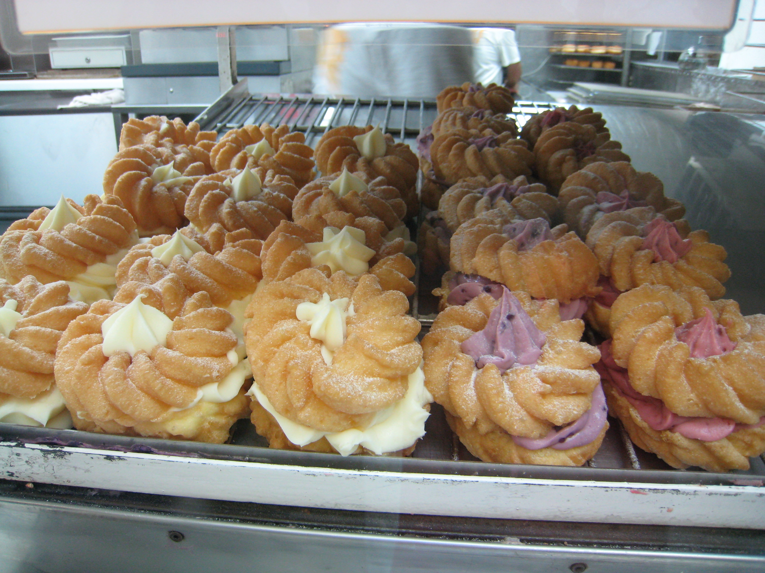
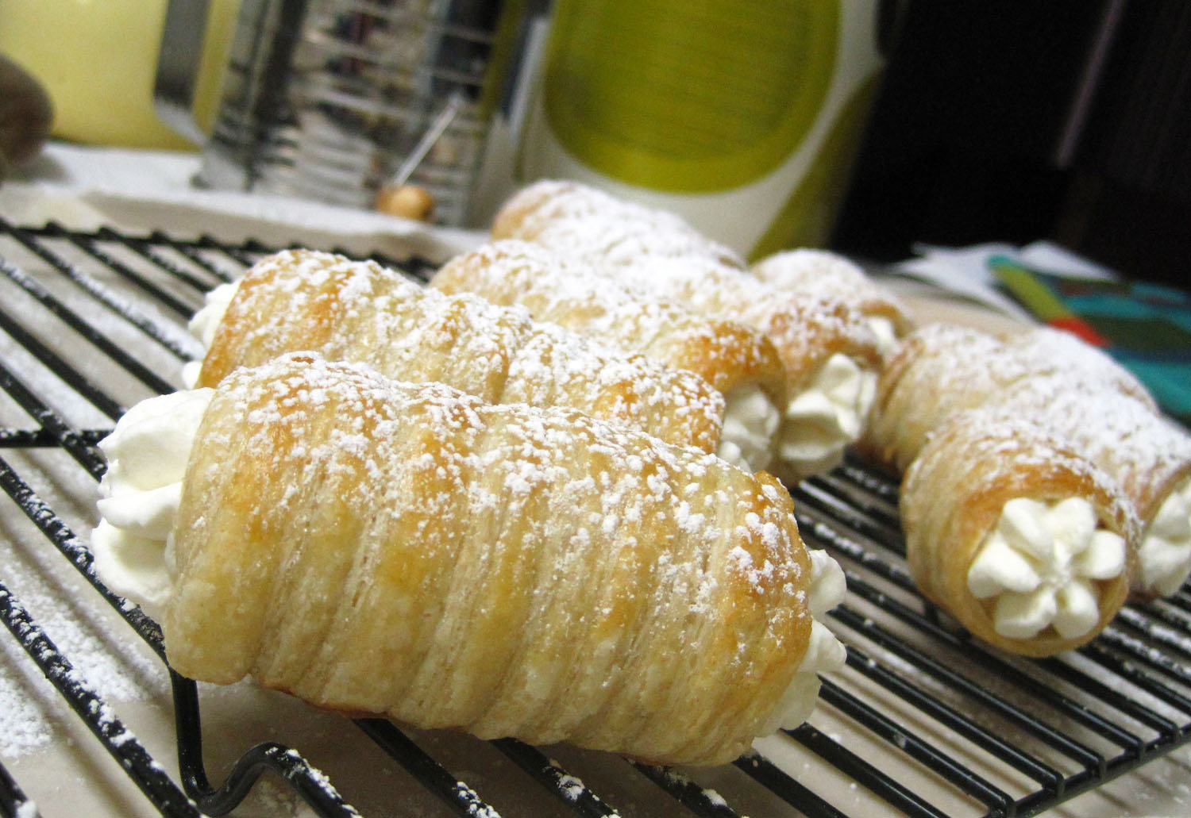
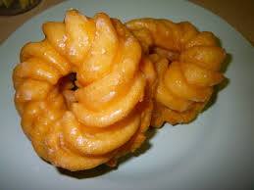
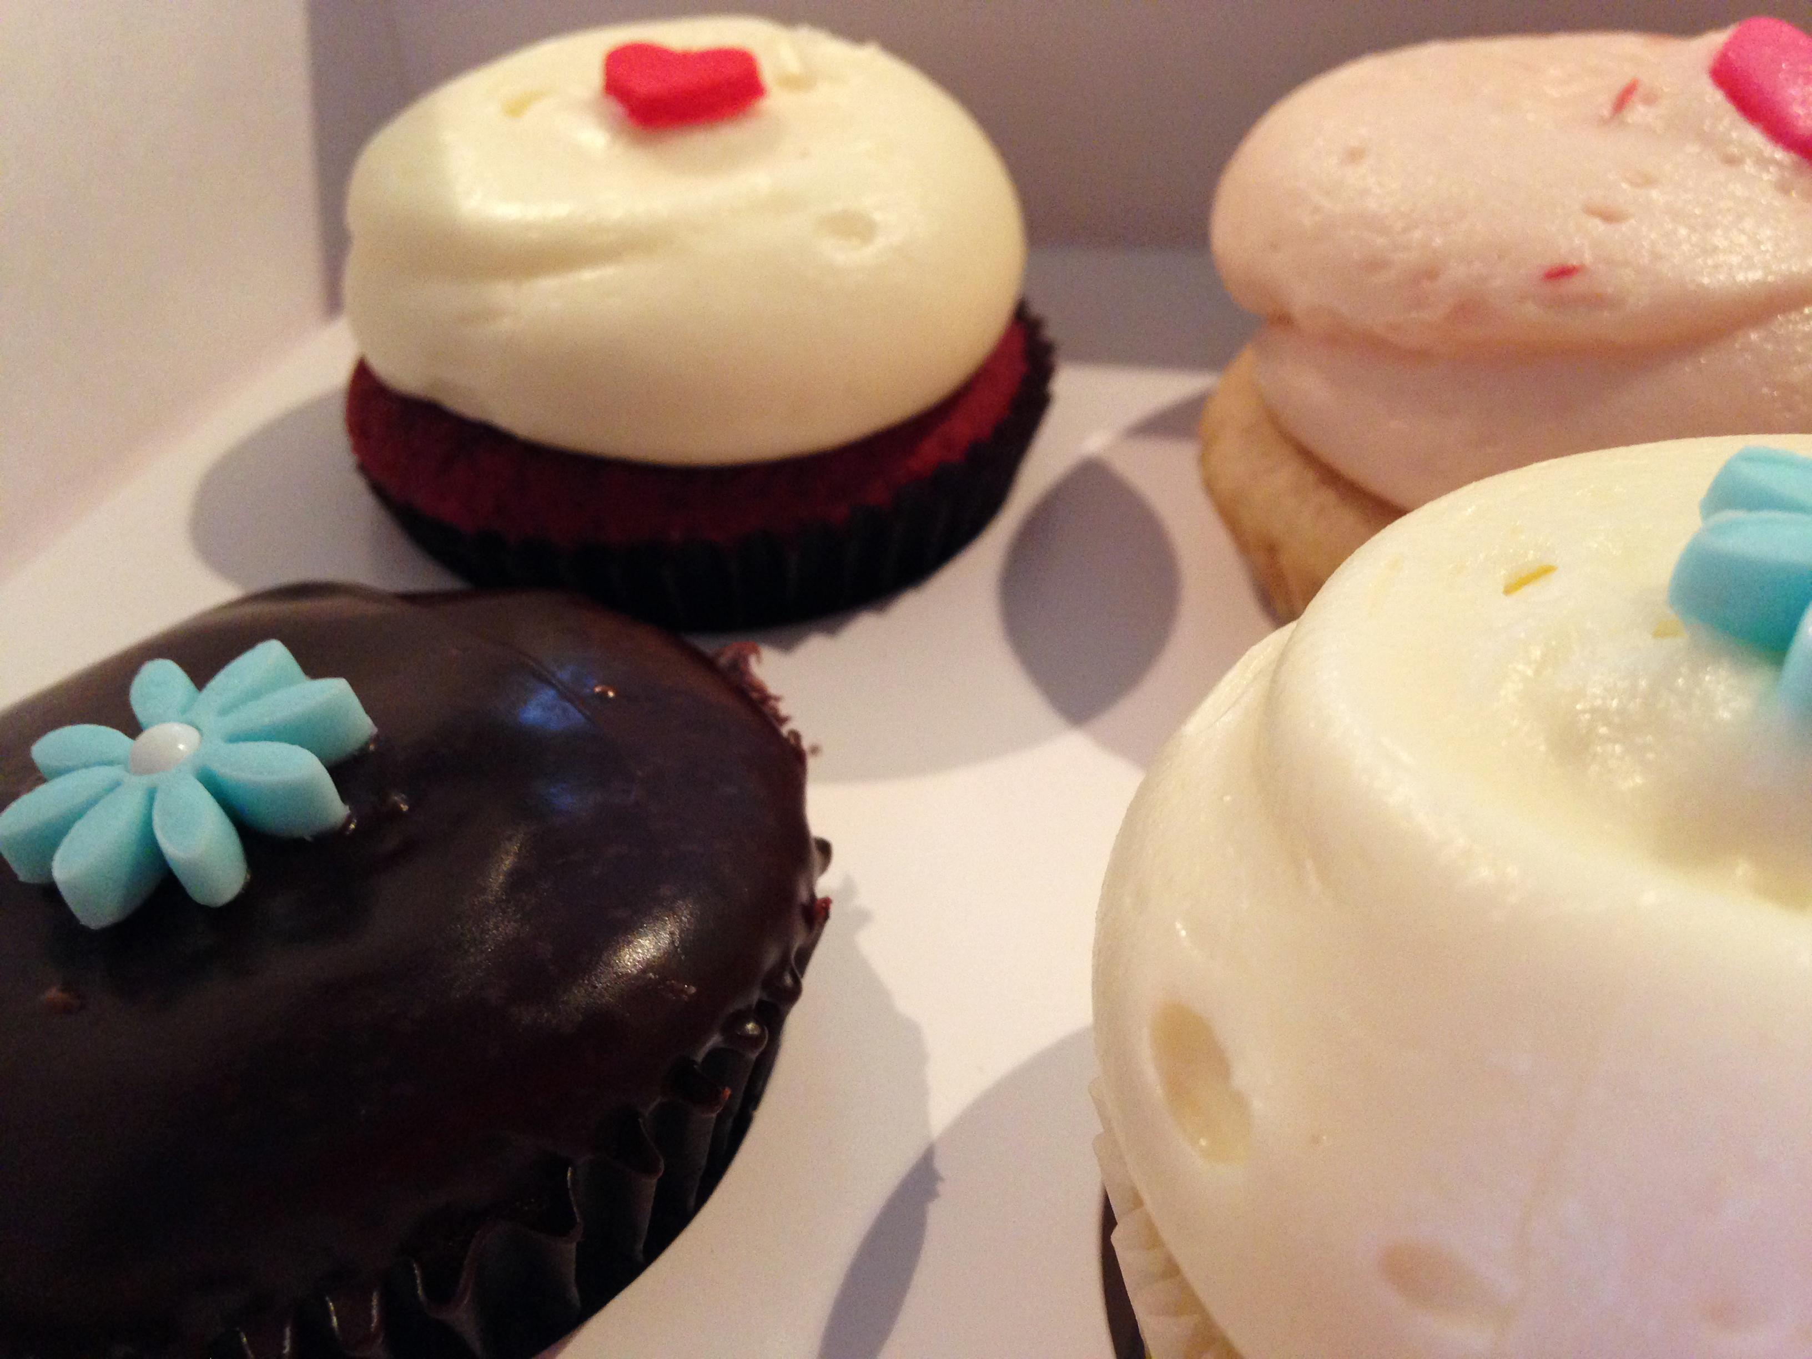
Menu About Us Contact
Take a look at few our best sellers
Pinwheels
Bulls-Horn
French-Twist
Marshmallow Mayhems
Menu:
Bakers Dozen Donuts: Regular donuts, Chocolate frosted, vanilla frosted, Boston cream, jelly filled, glazed, marble twist, sugar raised, plain donuts, plain cruller, honey wheat, jelly puff, cream puff, coffee roll…………………………………………. (13) $8.65
Regular Donuts: Chocolate frosted, vanilla frosted, Boston cream, jelly filled, glazed, marble twist, sugar raised, plain donuts, plain cruller, honey wheat, jelly puff, cream puff, coffee roll…………………………………………………………………………..(1) $1.05
Fancy Donut: fancy donuts: bow tie, éclair, apple turnover, fancy coffee roll……………………….....................................(1) $2.00
French Cruller:………………………………………………………………………………………………………………………….(1)$2.00

Slide 3
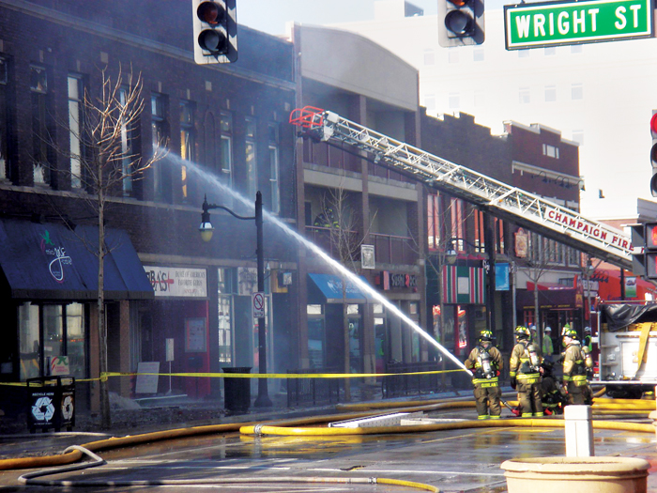
Menu About Us Contact
About Us:
Donut Delights was started in 1971 by Melvin Furballski, an immigrant baker from
the far east coast of Poland. Known far and wide for his delicate pastries, Melvin fled his
homeland in search of a better life for his family. In 1970 he landed in New York City and by chance he found an open seat on a bus heading west. When an unexpected mechanical failure forced a three day delay in Champaign, Illinois, Furballski saw the need for a donut shop, so he decided to stay and make a new life for himself in Urbana, Illinois. With only one hundred dollars to his name, he found an abandoned bread shop and within two days he had one of a kind donuts flying off the racks faster than he could bake them and things have never slowed down. Now you can find that same great donut recipe plus dozens more still being made with the same love and care as when Donut Delights first opened. A bakery fire in the mid-1980s destroyed many of the shop's records...but NOT THE RECIPES. While many people might have viewed the fire as an excuse to quit, Melvin instead used it as an opportunity to reconfigure the interior design, allowing him to add the coffee roastery section as well. So when you visit, be prepared for the inviting mix of aromas from fresh-roasted coffee beans and fresh-baked donuts: It's the closest thing to "Breakfast Heaven" anywhere in the C-U area

Slide 4
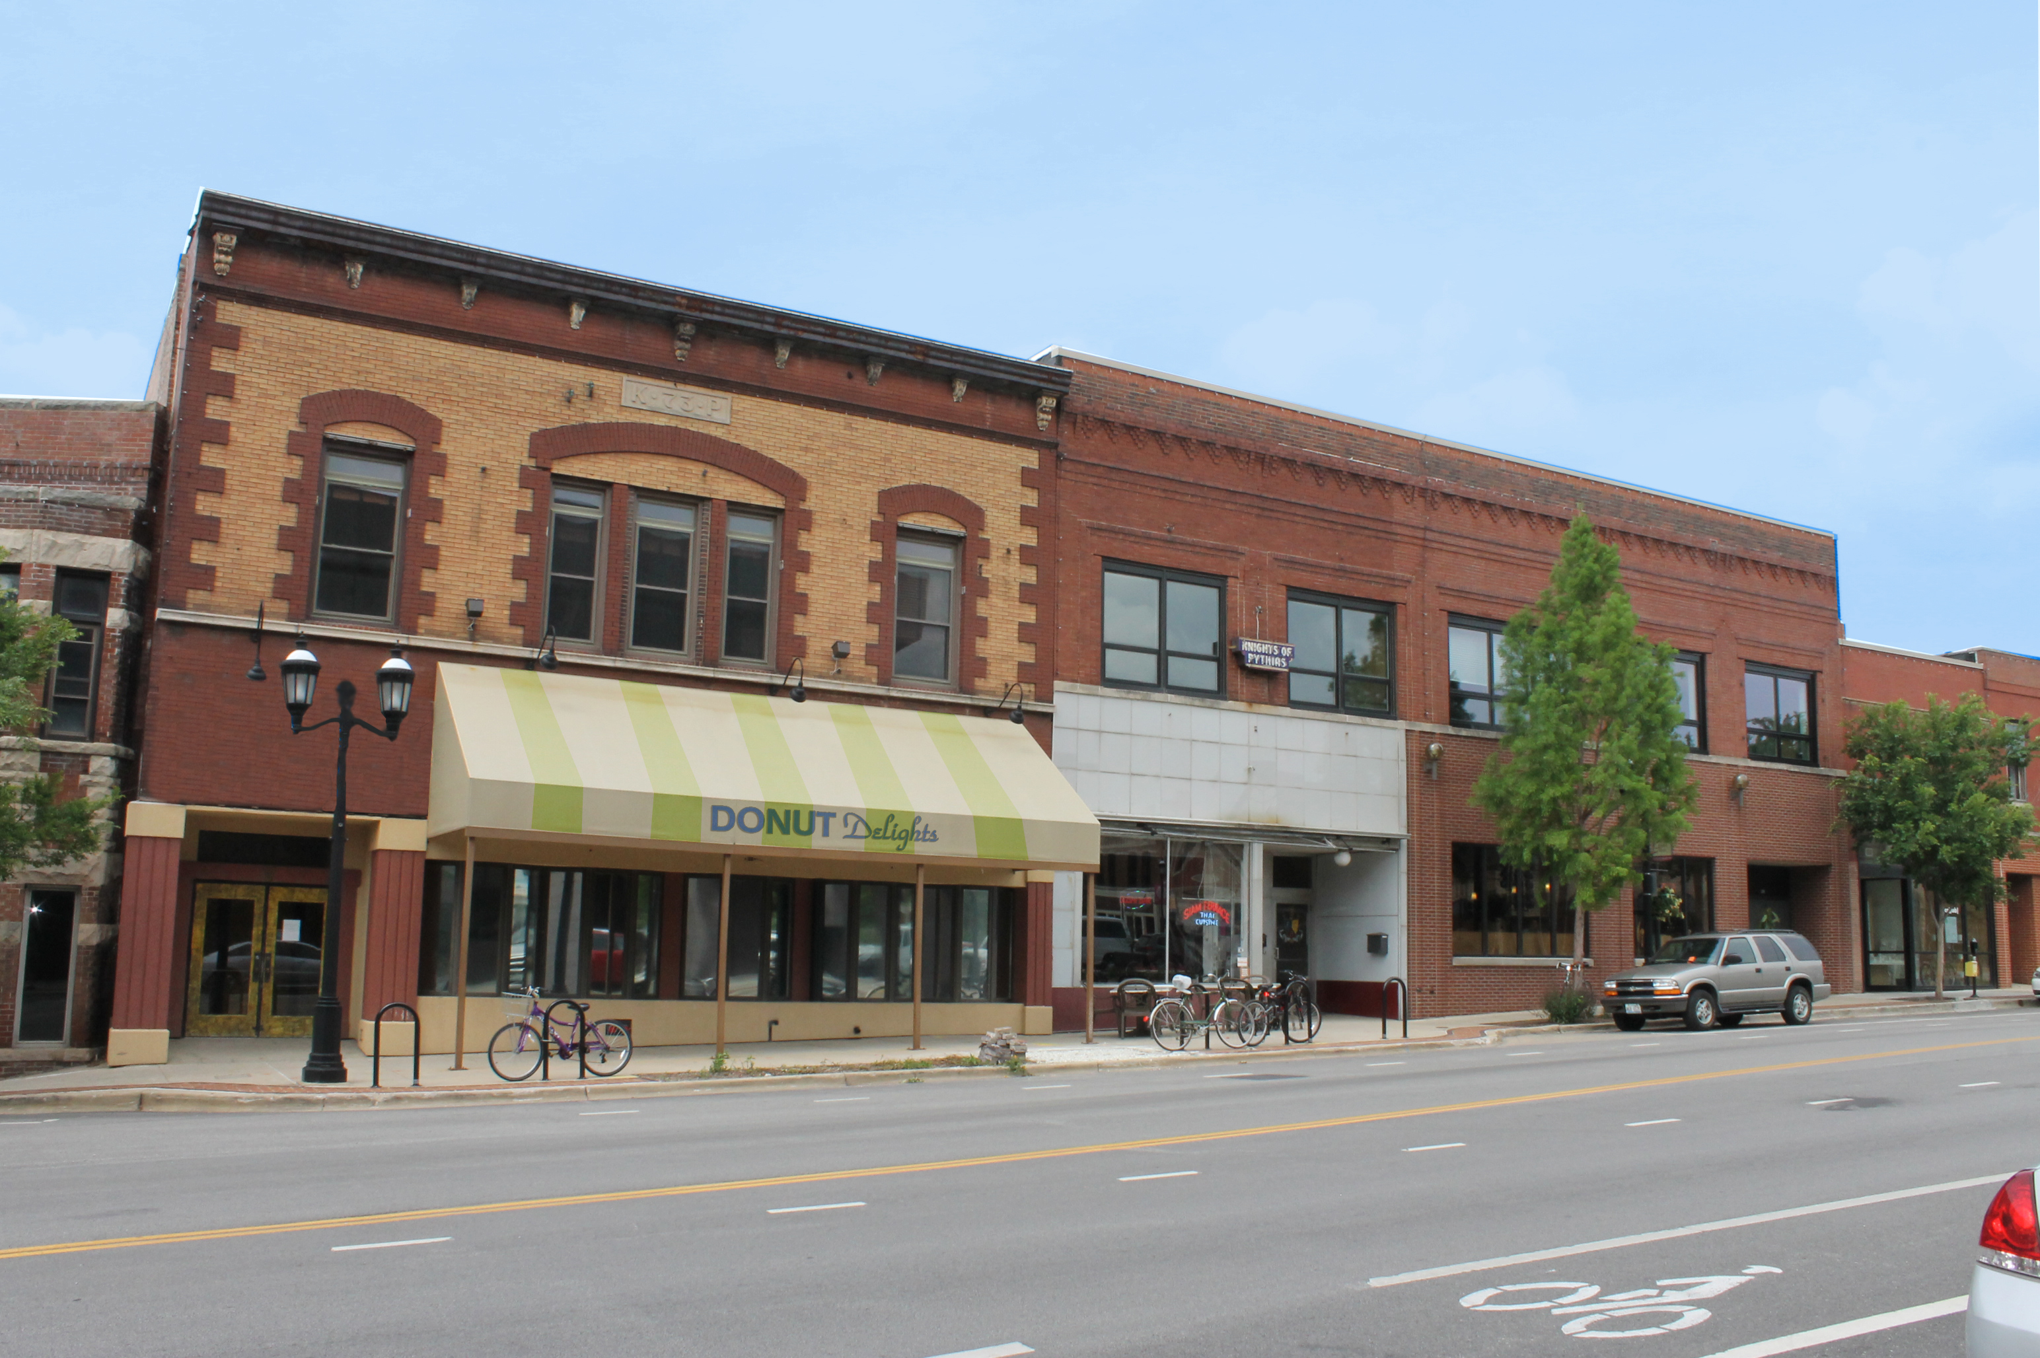
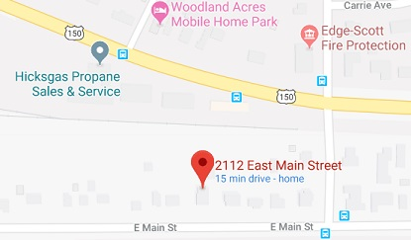



Menu About Us Contact
Get in touch with us
Donut Delights
2112 Main Street Urbana, Illinois 61801
Phone: (217)-552-1234
Email: contact@donutdelgihts.com
Hours:
Monday 5:30am-4:00pm
Tuesday 5:30am-4:00pm
Wednsday5:30am-4:00pm
Thursday5:30am-4:00pm
Friday 5:30am-4:00pm
Saturday 8:00am-4:00pm
Sunday 8:00am-4:00pm
Sign up for our email list to receive exciting new and special deals.
Email:
Connect with us on our social media
Fun donut joke
Why did the donut go to the dentist? To get a filling.

